Slide 1
“Stranger detector
Abdou-Aziz Gajigo
Jean Rene

Slide 2
Problem description
The objective is to develop a Stranger detection system for homesecurity cameras. This will let homeowners know when a stranger is detected.
it Identifies Homeowners and Strangers Using Pretrained Image Data
what we are trying to do is to enhance security cameras that will notify homeowners if someone who does not live in their house shows up.
To represent the problem, we labeled images (homeowner and stranger).

Slide 3
project overview
Objective:
Create a facial detection system that uses AI/ML models to classify images as "Homeowner" or "Stranger."
Key Features:
Sources training, validation, and testing data from folders.
Uses Convolutional Neural Networks (CNNs) for image classification.
Predicts and labels new images.
Saves the trained model for future use.

Slide 4
Tools we used
Frameworks and Libraries:
TensorFlow/Keras for building and training the model.
OpenCV for handling images data.
Matplotlib for visualizing predictions.
NumPy for numerical operations.
Programming Language: Python
Development Environment: visual studio code

Slide 5
how we prepared our data
Data Preparation
Training and Validation Datasets:
Images are sourced from directories (training, validation).
Images are rescaled to normalize pixel values (1/255).
Classes are labeled as binary:
0: Homeowner
1: Stranger

Slide 6
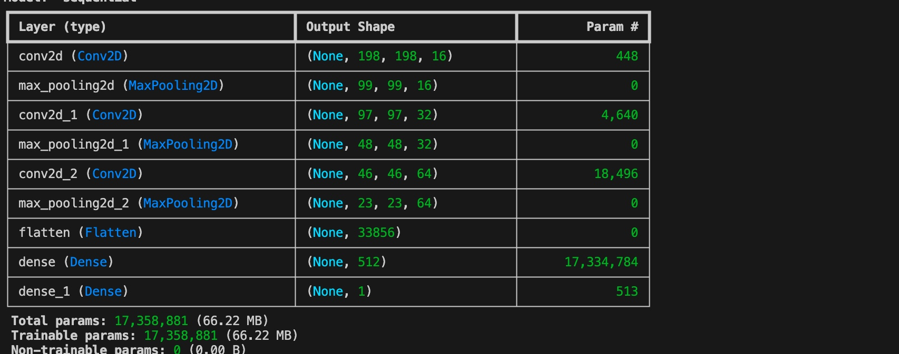
Model architecture
•Layers:
Convolutional layers for feature extraction.
MaxPooling layers to reduce spatial dimensions.
Flatten layer to convert 2D arrays to 1D vectors.
Dense (fully connected) layers for classification.
Activation Functions:
ReLU for intermediate layers.
Sigmoid for the output layer (binary classification). 0 and 1

Slide 7
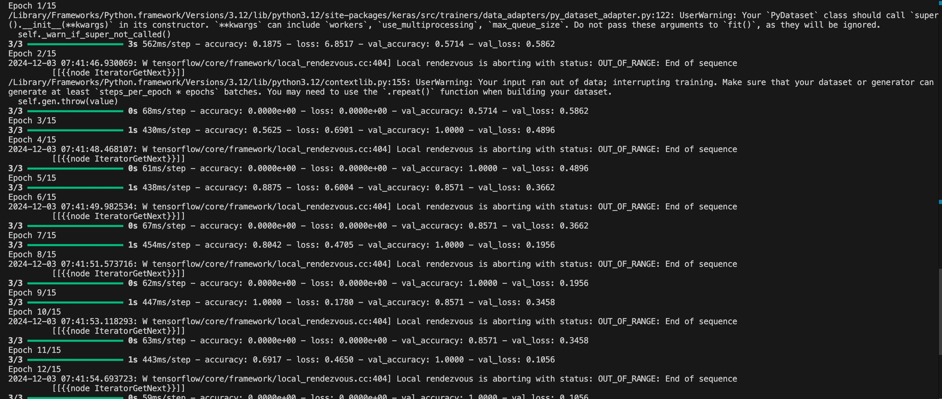
Model Training
Loss Function: Binary Crossentropy
Optimizer: RMSProp (learning rate = 0.001)
Metrics: Accuracy
training Details:
Steps per epoch: 3
Total epochs: 15
we used training and Validation data .

Slide 8
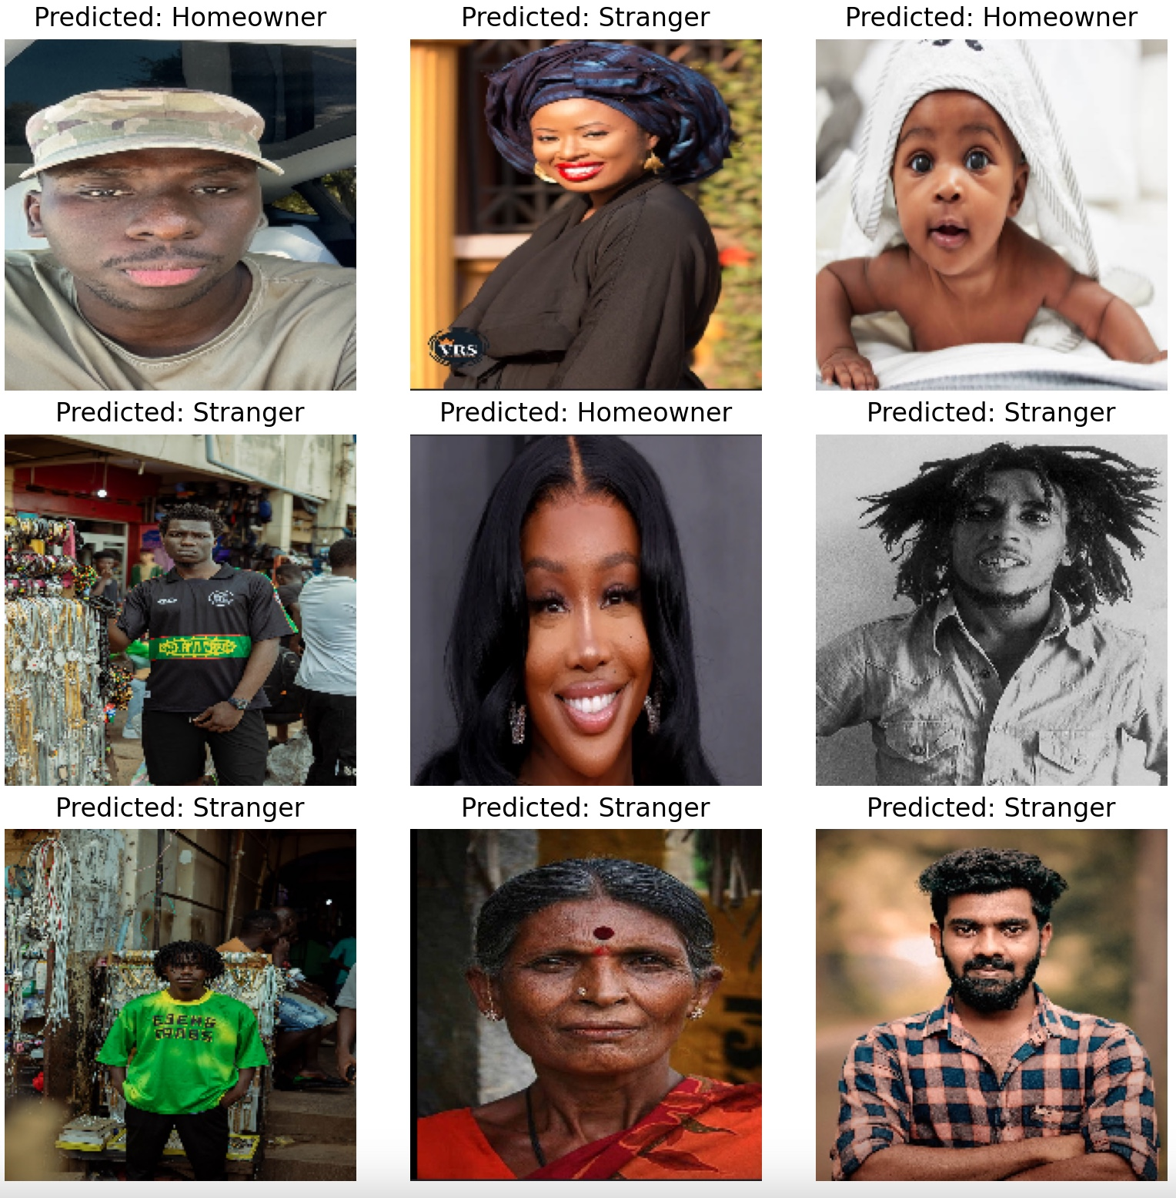
Testing and final results
•Testing Process
Preprocess testing images (resize, normalize).
Predict class labels using the trained model.
Display results with matplotlib.

Slide 9
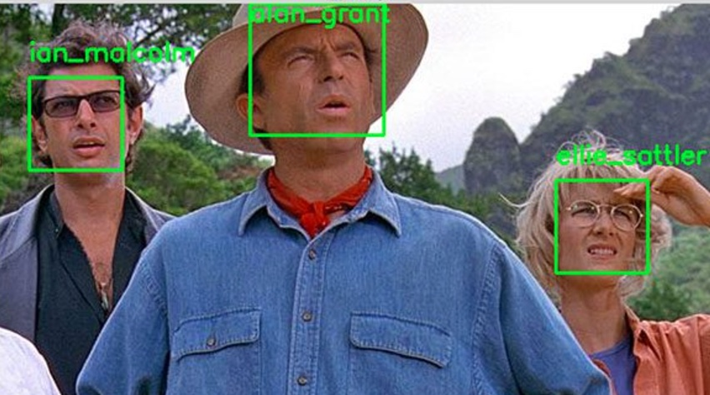
Challenges and Future Work
Challenges:
real time video streams
Handling edge cases (e.g., unclear or partial faces).
Future Enhancements:
Include support for real-time video streams.
Expand the model for multi-class classification for example delivery drivers.
Add a notification system to alert homeowners when a stranger is detected.

Slide 10
Timeline (4 weeks)
Week | Tasks | Details
Week 1 | Data collection and preparation | - Select pre-trained models (SSD, YOLO). - Download and prepare COCO/PASCAL VOC datasets. - Augment dataset to increase diversity. - Annotate any additional custom data if needed.
Week 2 | Model training and pre-setup | - Set up TensorFlow Object Detection API. - Train the model on pre-trained weights (transfer learning). - Fine-tune the model for object classes (pedestrians, cars, traffic signs).
Week 3 | Testing and training evaluation | - Evaluate model using mAP and IoU. - Test model on real-time video streams (OpenCV). - Adjust parameters (learning rate, augmentation) for performance improvement.
Week 4 | Final Integrating & Reporting | - Deploy the model for real-time object detection. - Test on real-world video or dashcam footage. - Prepare project documentation, performance metrics, and demo results.

Slide 11
Resources
Coco for common objects in context. https://cocodataset.org/#home
Voc dataset yolo docs. https://docs.ultralytics.com/datasets/detect/voc/
Simulator platform Carla. https://carla.org/
Data augmentation using tensor flow. https://www.tensorflow.org/tutorials/images/data_augmentation
Pre-trained object detection models. https://developers.arcgis.com/python/latest/guide/how-ssd-works/#:~:text=SSD%20has%20two%20components%3A%20a,classification%20layer%20has%20been%20removed.
Mean average precision to evaluate detection performance. https://jonathan-hui.medium.com/map-mean-average-precision-for-object-detection-45c121a31173
Intersection over union. https://pyimagesearch.com/2016/11/07/intersection-over-union-iou-for-object-detection/
OpenCV: For image processing and real-time video capture from the camera. https://stackoverflow.com/questions/41121449/detect-objects-with-opencv-python
Labeling tool labelmg. https://medium.com/@praveenbarange55/simplifying-data-annotation-with-labelimg-a-comprehensive-guide-236ecf549284#:~:text=Drawing%20Bounding%20Boxes%3A,start%20drawing%20a%20bounding%20box.

